Slide 1

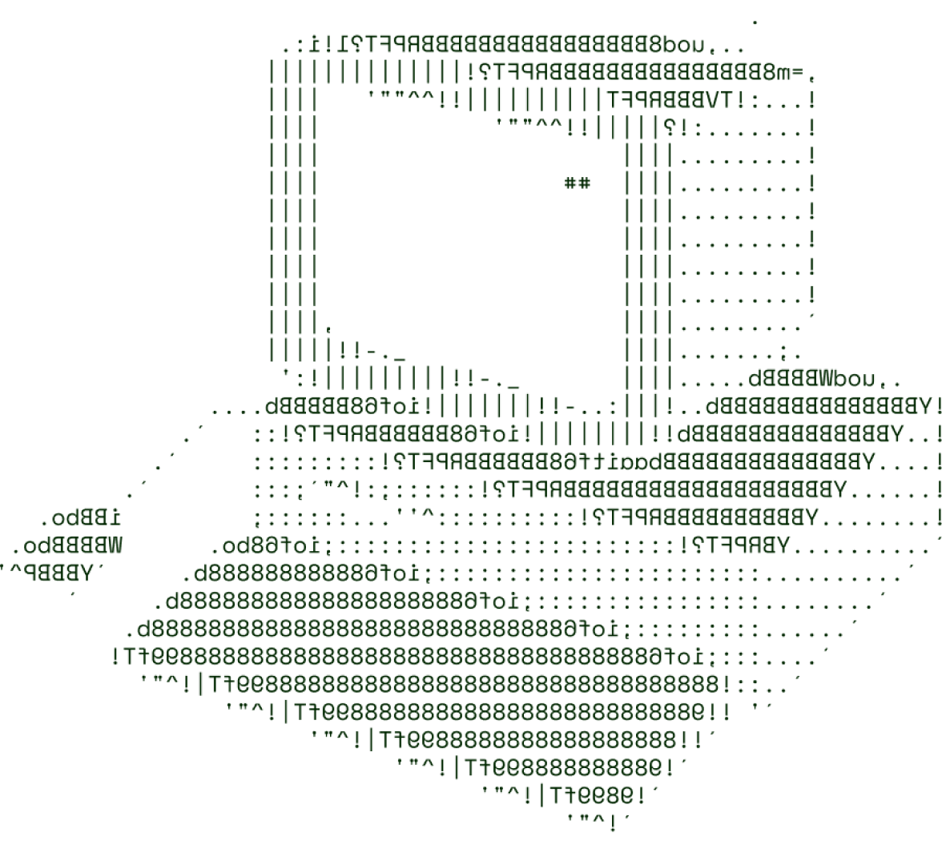

Park Plaza: Revolutionizing Parking
in Crowded Cities
Pi-rates

Slide 2

The Problem: Parking Frustrations in Urban Areas
1
Limited Parking Availability
Unclear Pricing and Restrictions
2
Congested cities often have a shortage of designated parking spaces, leading to endless circling and wasted time.
Navigating the complex web of parking rates, time limits, and regulations can be confusing for drivers.
3
Increased Traffic and Emissions
The constant search for parking contributes to higher traffic congestion and environmental pollution.

Slide 3
The Park Plaza Solution: A Comprehensive Parking App
Real-Time Parking Data
Seamless Booking and Payment
Intelligent Recommendations
Park Plaza taps into a network of sensors and data sources to provide up-to-the-minute information on parking availability and pricing.
The app's algorithms provide personalized suggestions on the best parking options based on user preferences and location.
Users can easily reserve and pay for parking spots directly through the app, streamlining the entire process.

Slide 4

TECHNICAL ARCHITECTURE
Flowchart (Not Compulsory)
Tech stack
Frontend Technologies : React,Angular
Backend Technologies : Node.js , java
Database : MongoDB Dockers

Slide 5
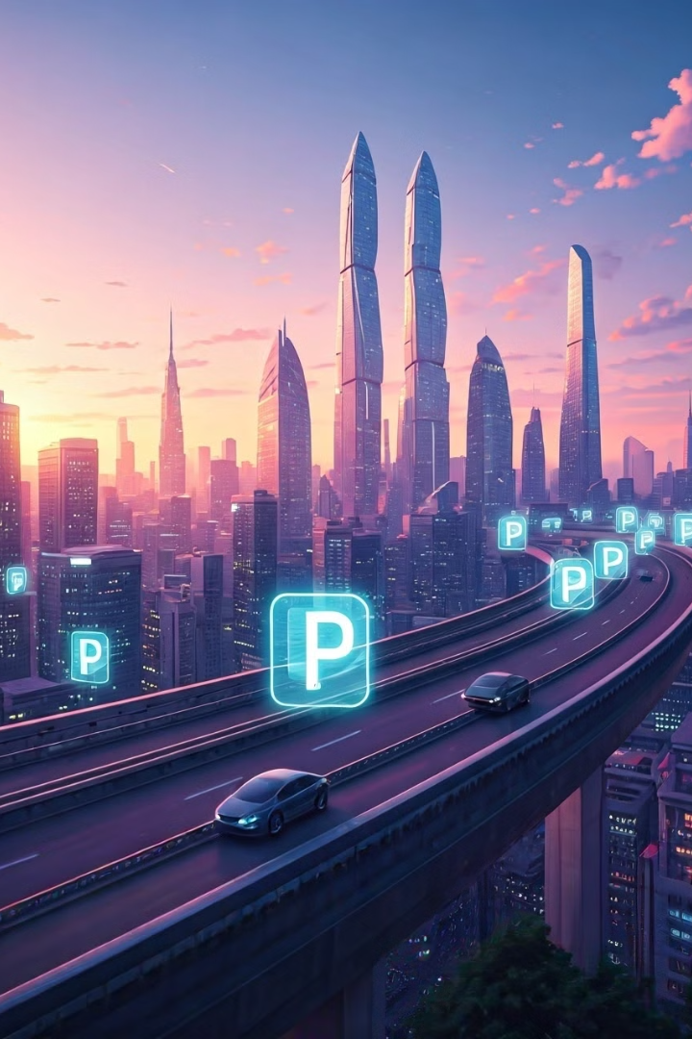
The Future of Parking: Park Plaza's Roadmap
1
Autonomous Parking
Park Plaza plans to integrate with self-driving car technologies to enable fully automated parking and retrieval.
2
Dynamic Pricing Models
Continued advancements in predictive analytics will allow for more sophisticated and responsive pricing strategies.
3
Integrated Mobility Solutions
The app will expand to include seamless connections with other transportation modes, such as public transit and ridesharing.

Slide 6
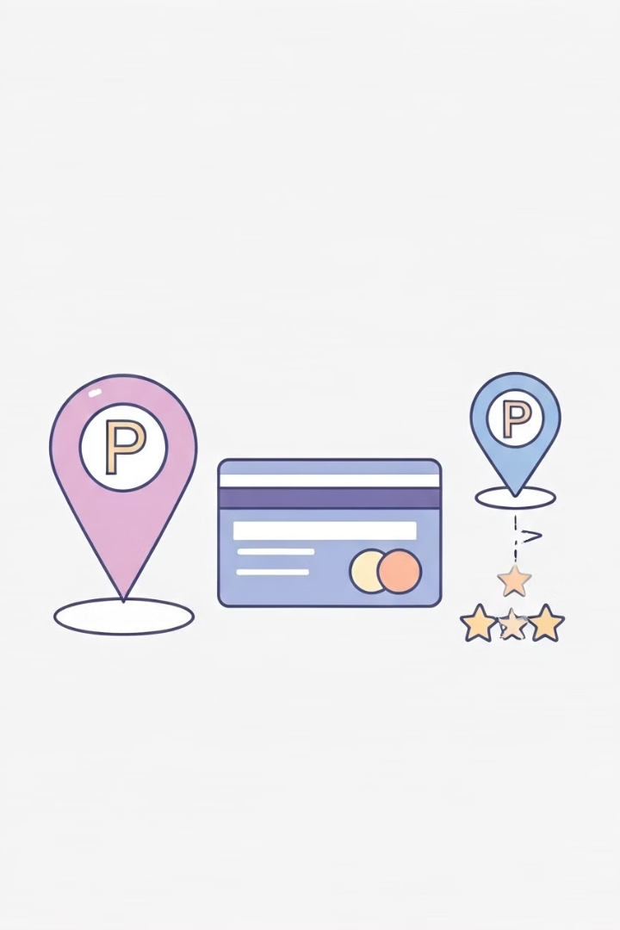




Key Features of Park Plaza
Parking Availability
Seamless Booking
Real-time updates on open parking spots, including pricing and restrictions.
Intuitive in-app parking reservations and mobile payments.
Navigation Assistance
Personalized Insights
Turn-by-turn directions to guide drivers to their reserved parking spots.
Customized parking recommendations based on user preferences and patterns.

Slide 7

>Team Details

Slide 8




MaruganiReddi sekhar
P.Yaswanth
Student
VITAP-UNIVERSITY
Student
VITAP-UNIVERSITY
K.Mohammad razwin
M.Abinay
Student
VITAP-UNIVERSITY
Student
VITAP-UNIVERSITY

Slide 9

Thanks for Joining

